Slide 1
FCE Informal Letter & Email Workshop

Slide 2

Imagine:
Your friend Alex is from London.
Although you don’t see each other often, you stay in touch using Whatsapp and email.

Slide 3
With a partner...
Read the texts from Alex. How would you respond? Make a note of your replies to her texts so we can review them later.
Remember a conversation requires two people! Don’t just answer “okay” or “yes/no”
Hi!

Slide 4
Text 1
I’m really happy you’re coming to visit me and my family in London! 😁

Slide 5
Text 2
What places would you like to visit while you’re here?

Slide 6
Text 3
What would you like to do in London?

Slide 7
Text 4
I was thinking we could go to a rock concert or to a dance performance. Which do you prefer? 🎸💃

Slide 8
Text 5
Also, we could go to the beach if you don’t mind if the water is cold. 🏖⛄

Slide 9
Let’s review the conversation:
Alex:
I’m really happy you’re coming to visit me and my family in London! 😁
What places would you like to visit while you’re here?
What would you like to do in London?
I was thinking we could go to a rock concert or to a dance performance. Which do you prefer? 🎸💃
Also, we could go to the beach if you don’t mind if the water is cold. 🏖⛄
You:
1. Hey! I . . .
2. I’d love to . . .
3. I really want to . . .
4. I prefer / I would rather . . .
5. I think . . .

Slide 10
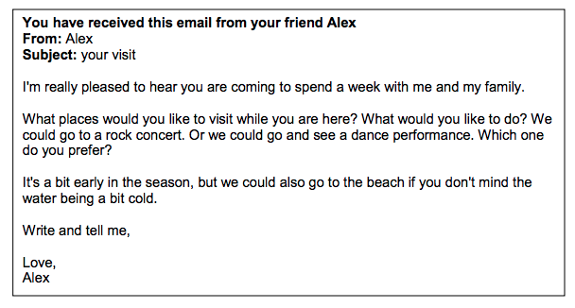
Exam Task
Can you identify the questions you answered during the texting exercise? What information did I add to the texts that doesn’t appear in the task?
These questions come directly from an FCE email task.

Slide 11
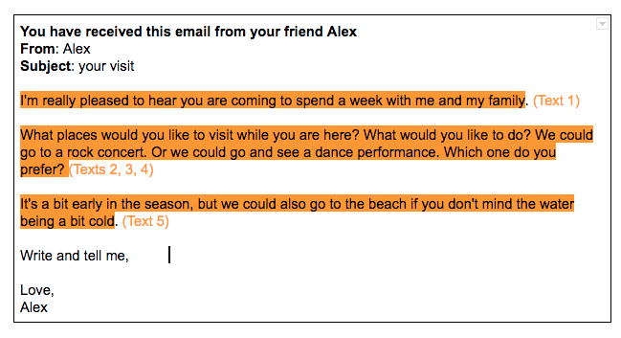
Exam Task
In the texting activity, I added this information: Alex is from London.
Sometimes it is necessary to invent information in order to fully reply to the email. The invented information should be logical and fit with the theme of the task.
In the texting activity, you’ve already answered all the questions in the task.

Slide 12
Exam Task
With your partner, use your replies to Alex’s texts to write the email.

Slide 13

HOMEWORK
Complete another email
Before you start writing, imagine that the person you’re writing to is your friend.
What would you say to a real friend who asked you these questions?
Can you answer all the questions, or do you need to invent information about your friend in order to do so?

